Slide 1


Presented by-
Nakshatra Ghosh
Aradhana Banerjee
Gunjan Lunia
Ritobhash Daw
Spandan Dutta
Tista Dutta
Diya Lepcha
BEYOND BORDERS:
Unravelling the economic tapestry of women’s migration

Slide 2
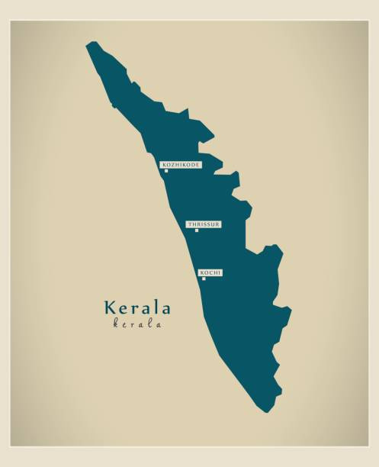
Unveiling Job Satisfaction among Female Migrants:
A Case Study of Kerala
Kerala is economically behind but ahead in terms of education when compared to other states. Due to its issue of unemployment, a large section of their educated youth including women migrate out.

Slide 3
The problems commonly faced by most of the female workers are related to accommodation, language, new social life, job dissatisfaction and health issues.
Studying the sample of the female migrates from Kerala to Mumbai living in hostels, Reshmi (2005) finds that:
Most of them are permanent workers in private sector.
The work time for most of them is 8 hours but a fraction of them work more than this.
A fair proportion of them face discrimination and exploitation in their jobs.
Most of them are happy with their current jobs but are still looking for better opportunities.
One-fourth of them are not satisfied with their jobs.

Slide 4

Wage Dynamics, an Analysis of Disparity
By Gender
Female rural migrants face significant wage gaps, with 13% earning less than Rs 100 daily compared to only 3% of men, and only 0.2% of women earning Rs 250 and above, contrasting with 23% of men.
In urban areas, 60% of female migrant workers earn less than Rs 5,000 monthly, while just 7% of male migrants fall into this category.
By Location
In rural areas, the average real wage is Rs 175, with female migrants earning just 78% of the amount. In urban areas, where the wage is more than twice as high at Rs 384, female migrants earn only 37% of it.
Consistent patterns can be seen across weekly and monthly earners in both rural and urban regions.
32% of women migrants in rural areas and 45% in urban areas are paid at minimum wage rates, with only a small percentage receiving wages above the statutory minimum.

Slide 5
A look at the “invisible workforce” during COVID
In this section we will focus on a study conducted by a team of researchers affiliated with Inclusion Economics at Yale University enrolled approximately 4,600 displaced migrants and followed them from April 2020 through July 2021 as they returned to two of India’s poorest states.

Slide 6
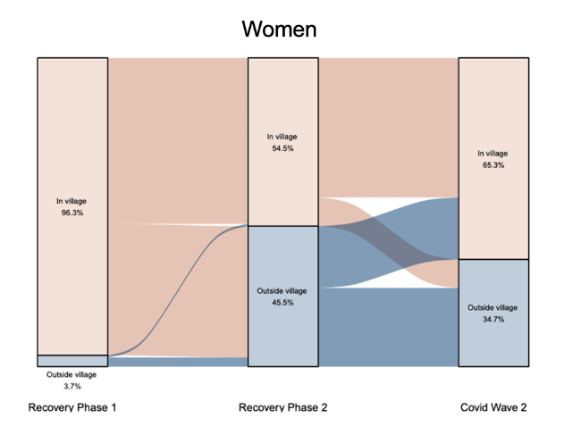
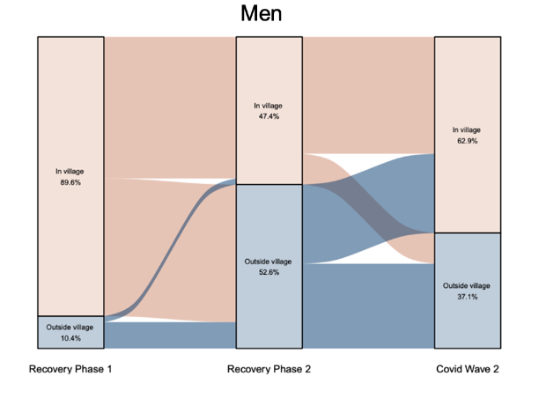
Pattern of Remigration
Looking across waves, 63 percent of men remigrated at least once, compared to 55 percent of women.

Slide 7
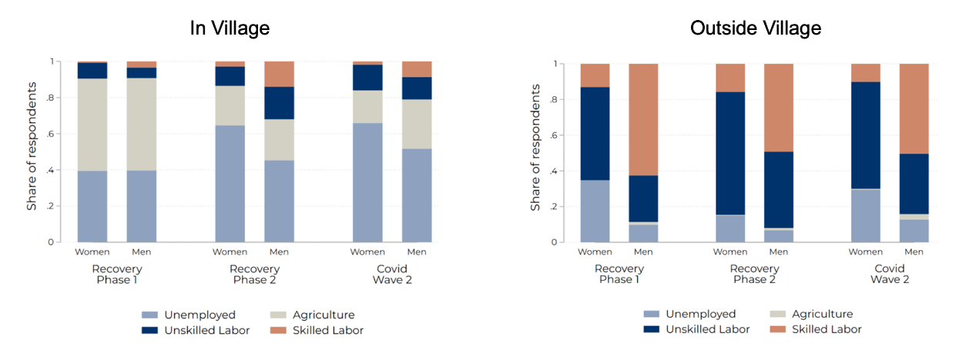
Pattern of Unemployment
Women are more likely than men to remain unemployed, even if they remigrate.

Slide 8
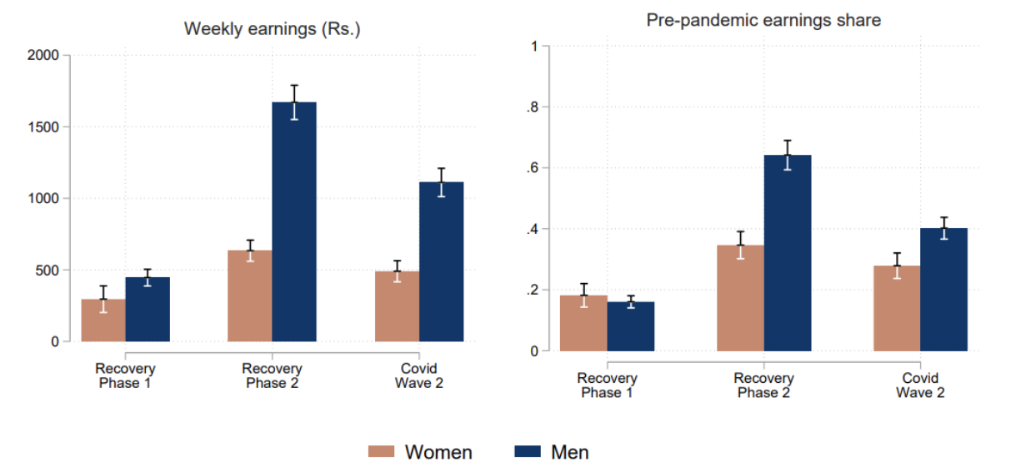
Pattern of Earnings
As the economy improved, male but not female migrant income rebounded significantly.

Slide 9
Tying the Knot, Crossing Borders:
Marriage Migration
Marriage migration is by far the largest form of migration in India and is close to universal for women in rural areas. Approximately 20 million women in India, annually migrate to live with their husband’s family.

Slide 10
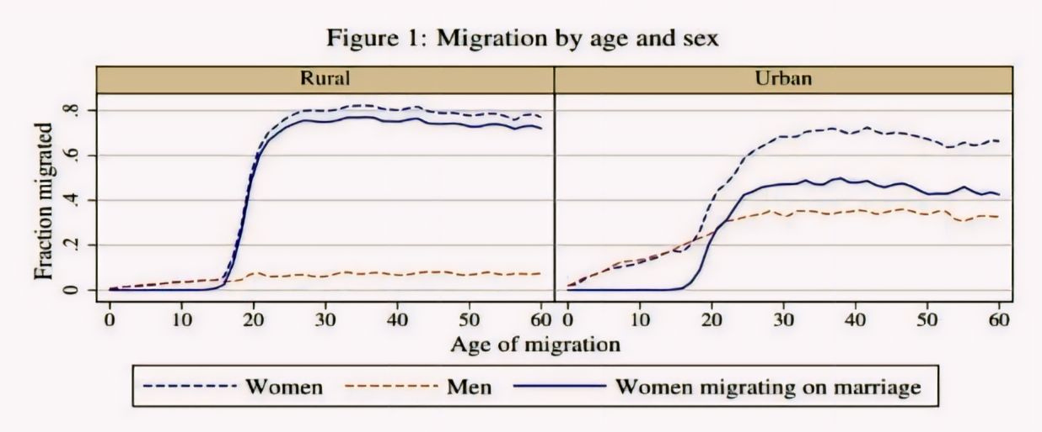
Most of India practices some form of patrilocal village exogamy in which women are married outside of their natal village.
Source: Survey data from the 64th round of NSSO.

Slide 11
Drivers Underlying Marriage Migration
Marriage migration serves as a form of economic insurance, reducing consumption uncertainties for both families in the face of unpredictable factors like poor harvests.
Marriage migration responds to areas with imbalanced sex ratios, where the demand for brides is higher, creating a pull factor for women to move to regions with lower female-to-male ratios.
Parents seek eligible bachelors outside their immediate communities, generally in some nearby towns or villages, to ensure their daughters have fulfilling lives after marriage and to elevate their social standing.

Slide 12


Migrating Women- A Boon…
Women migrants find better job prospects and higher wages, lifting themselves and their families out of poverty and improving living standards. Migration offers safety from unsafe environments and fosters security. Internally, female migration drives economic growth, notably in export-oriented sectors, crucial for rural-to-urban migration’s impact.
But this barely shows the true picture…..

Slide 13
….or Bane ?
In Indian export processing zones, increased female participation accentuates market segmentation, undervaluing and underpaying female-dominated roles. Multiple migrations strip women of social security and support, amid childcare challenges, hostile environments, and underutilization of skills. Migration perpetuates gender stereotypes and can push women into sex work due to the gendered division of labor.
So, the answer to the question whether it is a boon on bane depends on each of the individual women’s journey after migration.

Slide 14

Policy Recommendations
Ensuring women’s representation in the implementation of NREGA, linking it to skill development for migrant women.
Establishing training centres to train migrant women engaging in domestic work.
Awareness campaigns should be launched to educate the migrating women about the labour laws and reduce the wage and salary discrimination between women workers and their male counterparts for the same work.
The female migrants report limited access to financial services and social protection schemes in destination cities. Therefore initiatives should be taken so that they can be made aware of their social protection schemes and financial entitlements.

Slide 15

Thank You!
"I am a Woman Phenomenally. Phenomenal Woman, that's me."
-Maya Angelou

